Slide 1
AirBnB – Market Segmentation and Insights
MGMT 687- AI for Business Decisions
Aryan Saxena
Himanshu Sharma
Ayush Gupta

Slide 2
Executive Summary
Introduction to AirBnB
Business Problem Overview
Data Source Description
Models Used and Results
Insights and Implications
Conclusion
Agenda

Slide 3



Executive Summary
Objective
Airbnb aims to enhance host network optimization by leveraging data-driven segmentation and predictive insights.
The goal is to identify actionable strategies for improving host performance, revenue, and service quality while strengthening the Superhost program.
Modelling
Market Segmentation: Hosts were grouped into six distinct clusters based on performance and characteristics using K-Means clustering.
Predictive Insights: Statistical and machine learning models predicted revenue drivers, Superhost probabilities, and key factors influencing Superhost status.
Stakeholder Insights
High performers (e.g., Clusters 2 & 4) excel in guest satisfaction and operational efficiency but need retention strategies to maintain leadership
Emerging potential hosts (e.g., Cluster 3) show growth potential but require support to sustain their momentum
Underperformers (e.g., Clusters 1, 5, & 6) face challenges with occupancy, pricing, and guest engagement but present opportunities for targeted interventions

Slide 4

Introduction to AirBnB
Airbnb is a global online marketplace that connects people looking for accommodations with hosts offering unique stays and experiences.
Founded in 2008
Global Reach: Airbnb operates in over 220 countries and regions with millions of active listings.
Diverse Offerings: From budget-friendly shared spaces to luxury villas, Airbnb caters to a wide range of travelers.
Community Focus: Hosts and guests can interact directly, fostering a sense of community and trust through detailed profiles and reviews.
Beyond Stays: In addition to accommodations, Airbnb offers "Experiences", curated activities hosted by locals, enriching travel experiences.

Slide 5
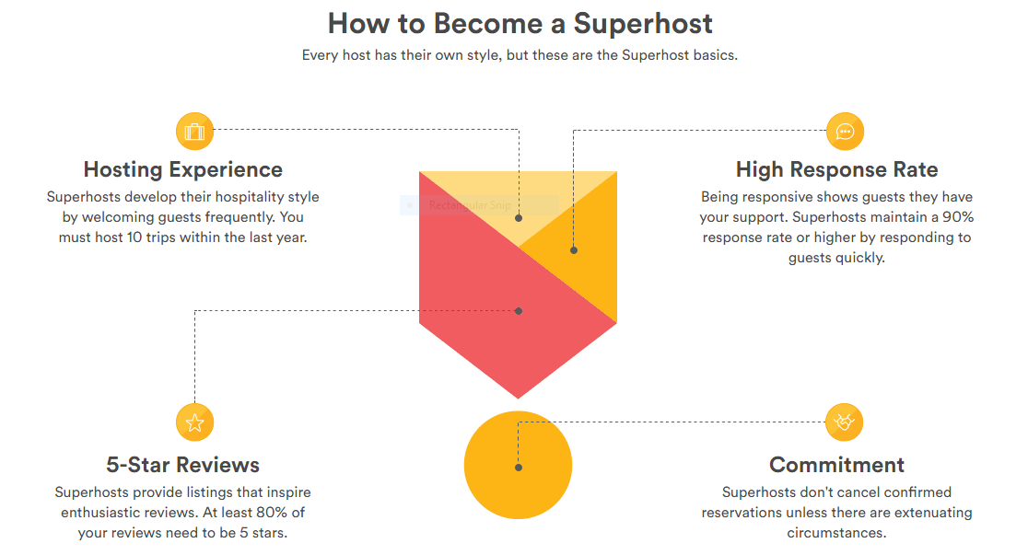
What are Superhosts?
Definition: Superhosts are Airbnb's top-performing hosts, recognized for exceptional service and reliability.
Evaluation: Hosts are assessed quarterly, with Superhost status valid until the next evaluation.
Criteria: Over 365 days, hosts must:
Host 10+ trips.
Maintain 90% response rate.
Have 0 cancellations.
Earn 80% 5-star reviews.
Benefits: Superhosts gain higher visibility, attracting more bookings and ensuring a trusted experience for guests.
Significance: The program drives service excellence, boosting Airbnb's reputation and customer loyalty.

Slide 6







Business Problem Overview
We would like to help AirBnB create Segmented Market Insights on their Host Network. This can be accomplished as follows:
Step 1: Market Segmentation
Step 2: Insight Generation
Segment the hosts based on their performance and characteristics as shown below:
Once the hosts have been segmented, we will generate predictive insights on them:
1. Revenue Key Driver Prediction – What are the key drivers of revenue for each segment?
2. Superhost Probability Generation – In each segment, how many hosts have a high probability of being a Superhost in the next period?
3. Superhost Status Key Drivers: What are the key drivers of hosts attaining superhost status?
Historical Performance
Property Characteristics
Hosts
Pricing Characteristics
Neighborhood Characteristics

Slide 7
Dataset Overview and Selection
We have selected Chicago as the city to run our analyses. A few summary data points:
120,217 rows
111 columns
13,689 Unique Hosts
25,845 Unique Properties
Key features: Broad and diverse dataset, capturing extensive information about Airbnb listings, hosts, bookings, and neighborhood demographics.
Why Choose Chicago?
Similar Scale: Other datasets are comparable in size, ensuring statistical robustness.
Greater Variability: Chicago's dataset reflects more diverse host and property profiles, enabling insights applicable to a wider range of markets.
Fewer Missing Values: Chicago has fewer missing values in critical metrics like bookings and revenue, ensuring more reliable and accurate analysis.
Chicago offers a similar scale compared to other datasets but provides more variability and lesser missing data, making it a better representation of a generic population.

Slide 8
Key Data Challenges
Missing Data
Skewness
Outliers
Correlation
Booking-related, Revenue and Occupancy metrics metrics, had up to 31.7% missing values.
Moderate missingness (10–20%) was also observed in variables like available_days .
Features such as revenue and tract_booking_share exhibited high skewness and variability.
The variability highlights diverse host strategies and guest behaviors.
Columns like rating_ave_pastYear had 511 outliers detected using Z-score.
Revenue and booking metrics had thousands of outliers identified using IQR.
Key features like tract_booking_share and tract_revenue_share showed high correlations (r > 0.8).
Dimensionality reduction via PCA was essential to handle these correlations.
The dataset presented significant challenges, including missing data, high variability, outliers, and multicollinearity, necessitating targeted preprocessing

Slide 9
Steps to Address Data Challenges
Missing Data
Skewness
Outliers
Correlation
Imputed missing values using the median for numerical features.
Applied normalization techniques (Yeo-Johnson transformation) to reduce skewness in key features.
Detected using Z-score and IQR, replaced with median values to reduce noise.
Dimensionality reduction using PCA to retain essential information while eliminating multicollinearity.
Preprocessing corrected ensures that the dataset is ready for robust analysis.

Slide 10
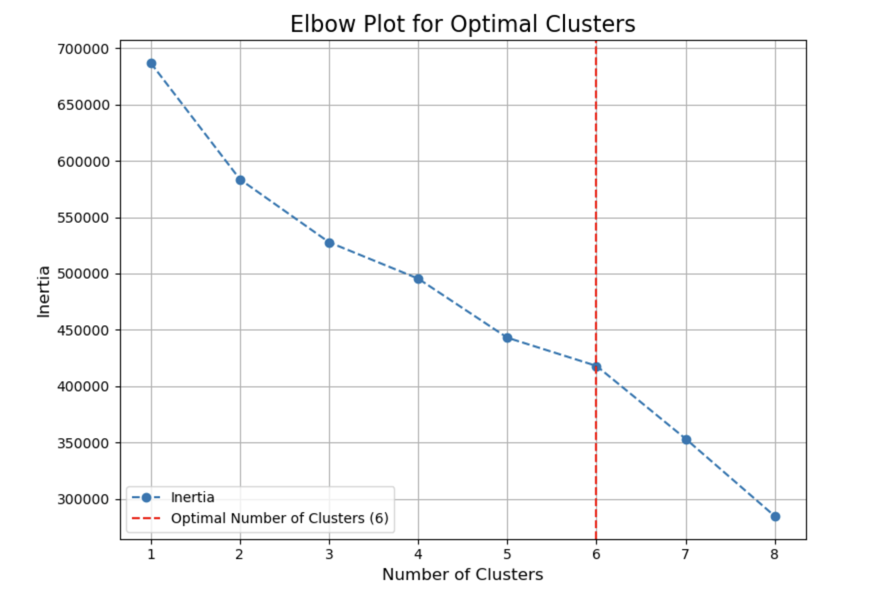
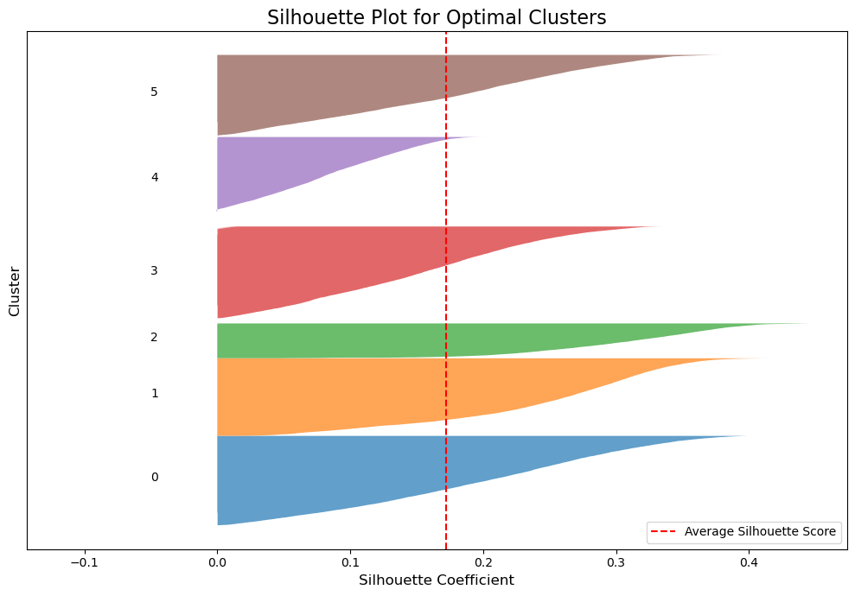
Market Segmentation – An Overview
Segmentation Ideology
Model Finalization
We’ve carried out the market segmentation based on the following characteristics:
We used an elbow plot and silhouette plot on the transformed data to identify the K=6 as the ideal number of clusters for our analysis:
Historical Performance
Property Characteristics
Hosts
Pricing Characteristics
Neighborhood Characteristics

Slide 11
Segment 1 – Hosts of Underperforming Properties
Historical Performance
Almost negligible share of hosts are superhosts, with no gains in status
Property Characteristics
Below-average size and capacity with minimal representation of entire apartments
Pricing Characteristics
Significantly below-average pricing and low competitiveness in the local market
Neighborhood Characteristics
Moderate superhost density but low overall population

Slide 12
Segment 2 – Hosts of Premium Properties
Historical Performance
Nearly all hosts are superhosts, though no recent gains were observed
Zero cancellations highlight strong reliability
Property Characteristics
Significantly above-average size and capacity. No private rooms or entire apartments
Pricing Characteristics
High pricing with highly competitive rates within the local neighborhood
Neighborhood Characteristics
High superhost density but a relatively low population in the local area

Slide 13
Segment 3 – Rising Superhosts
Historical Performance
All of the hosts are superhosts, with all gaining status recently
Zero cancellations reflect strong reliability
Property Characteristics
Average size and capacity. Some representation of entire apartments
Pricing Characteristics
Near-average historical pricing with highly competitive rates in the local market
Neighborhood Characteristics
Moderate superhost density and slightly above-average total population

Slide 14
Segment 4 – Stable Superhosts
Historical Performance
Nearly all of the hosts are superhosts, with no recent gains
Zero cancellations reflect strong reliability
Property Characteristics
Below-average size and capacity with minimal representation of entire apartments
Pricing Characteristics
Slightly below-average pricing with moderate competitiveness in the local market
Neighborhood Characteristics
High superhost density and slightly above-average total population

Slide 15
Segment 5 – Potential Superhosts
Historical Performance
Almost none of the hosts are superhosts, with no gains in status
Zero cancellations suggest consistently good performance
Property Characteristics
Significantly above-average size and capacity. Significant representation of entire apartments
Pricing Characteristics
High pricing with highly competitive rates in the local market
Neighborhood Characteristics
Moderate superhost density and below-average total population

Slide 16
Segment 6 – Budget-Friendly Hosts
Historical Performance
A small share of the hosts are superhosts, with no gains in status
Zero cancellations indicate consistent operations
Property Characteristics
Below-average size and capacity with minimal representation of entire apartments and private rooms
Pricing Characteristics
Slightly above-average pricing with the most competitive rates in the local market
Neighborhood Characteristics
Low superhost density but significantly above-average total population

Slide 17
Revenue Prediction
What are each segment’s key drivers of revenue?
Cluster
Features
Interpretation
High Performers
Clusters 2 & 4
Guest Satisfaction & Experience
Operational Efficiency
High Performers generate revenue through exceptional guest satisfaction
Efficient host practices, like quick response times, help these clusters maintain a strong revenue position.
Emerging Potential
Cluster 3
Location Quality
Guest feedback
This group benefits from historical pricing decisions but must continue refining strategies.
Hosts in this group can leverage the location's appeal in their listings.
Underperforming Segments
Clusters 1,5,6
Bookings
Price History
Increasing occupancy is a critical area for improvement.
There is a need for effective pricing strategies to compete better in the market.

Slide 18
Revenue Prediction
What do these key drivers have in common?
Consistent Bookings: Across all clusters, maintaining high occupancy is a key predictor of revenue. The ability to attract and retain guests consistently is fundamental for revenue generation.
Effective Pricing Strategies: Historical pricing trends play a significant role in predicting revenue. Hosts who optimize their nightly rates are better positioned to maximize earnings.
Guest Satisfaction and Engagement: Such metrics highlight the importance of positive guest feedback and high service quality. Satisfied guests not only leave positive reviews but are more likely to return.
Location Advantage : Properties in desirable or highly rated neighborhoods tend to perform better, indicating that location is a critical factor in attracting bookings.
Property and Amenities Quality: Such features influence revenue, reflecting the importance of offering competitive, well-equipped properties.
Operational Efficiency: Attributes relating to this show that quick and professional responses improve guest experiences, contributing to revenue.
Revenue is primarily driven by occupancy, pricing, guest satisfaction, and location. Hosts who excel in these areas, regardless of cluster, are better positioned to maximize earnings.

Slide 19
Superhost Probability Generation
In each segment, how many hosts have a high probability of being a Superhost in the next period?
Cluster | Average Probability
1 - Underperformers | 8.0%
2 – Premium Hosts | 92.5%
3 – Rising Superhosts | 75.9%
4 – Stable Superhosts | 92.5%
5 – Potential Superhosts | 9.5%
6 – Budget Friendly Hosts | 12.6%
Key Takeaways
High Performers (2 and 4): Stable, successful Superhosts who need recognition and retention strategies.
Emerging Potential (3): Recent achievers with significant growth potential who require support to sustain their momentum.
Underperforming Segments (1, 5, and 6): Struggle with low Superhost probabilities due to operational and service challenges but have opportunities for improvement through targeted interventions, especially for “Potential Superhosts”
The Average Probability for each cluster is calculated using the predicted probabilities of becoming a Superhost for all hosts within that cluster
Notes:
Cluster 0: Underperforming Properties
Average Probability: 0.080 (Very low likelihood of achieving Superhost status)
Total Hosts: 13,102
Superhost Likely Count: 301 (Only ~2.3% of hosts have a high probability of becoming a Superhost)
Insights:
Low Potential: The low probability reflects poor performance and limited appeal among these hosts.
Challenges: Cluster 0 struggles with below-average property characteristics, low pricing, and weak competitiveness.
Action Items:
Encourage hosts to improve service quality, reflected in better ratings and reviews.
Introduce pricing optimization tools to attract more bookings.
Offer training or resources to help hosts compete more effectively in their neighborhoods.
Cluster 1: Successful Superhosts
Average Probability: 0.925 (Very high likelihood of maintaining Superhost status)
Total Hosts: 11,327
Superhost Likely Count: 10,387 (~91.7% of hosts likely to retain Superhost status)
Insights:
High Stability: Most hosts in this cluster are successful Superhosts, reflecting strong service quality and high competitiveness.
Strengths: Premium properties with high pricing, large capacity, and excellent guest experiences drive this success.
Action Items:
Provide advanced tools to help these hosts maintain their performance.
Leverage these hosts as ambassadors or role models for other clusters.
Reward and recognize these hosts to sustain loyalty and motivation.
Cluster 2: Recent Superhost Achievers
Average Probability: 0.759 (Moderately high likelihood of retaining Superhost status)
Total Hosts: 5,083
Superhost Likely Count: 3,096 (~60.9% of hosts likely to retain Superhost status)
Insights:
Growth-Oriented: This cluster represents hosts who recently achieved Superhost status due to operational improvements and competitive pricing.
Vulnerabilities: While many hosts are doing well, some may struggle to sustain their performance due to moderate property characteristics.
Action Items:
Focus on retention strategies like continued training and guidance to sustain performance.
Offer insights into improving guest satisfaction and optimizing pricing for hosts at risk of losing their status.
Encourage continued innovation in guest services to build on their momentum.
Cluster 3: Stable Superhosts with Smaller Properties
Average Probability: 0.925 (Very high likelihood of maintaining Superhost status)
Total Hosts: 14,149
Superhost Likely Count: 13,003 (~91.9% of hosts likely to retain Superhost status)
Insights:
Consistency: This cluster reflects stable Superhosts who rely on strong service quality despite smaller properties and moderate pricing.
Strengths: High ratings, reviews, and superhost density in their neighborhoods contribute to their success.
Action Items:
Provide resources to help these hosts maximize their profitability without compromising service quality.
Recognize and reward their consistent performance to reinforce motivation.
Promote their success as a model for smaller properties in other clusters.
Cluster 4: High-Capacity Properties with Potential
Average Probability: 0.095 (Very low likelihood of achieving Superhost status)
Total Hosts: 13,064
Superhost Likely Count: 425 (~3.3% of hosts have a high probability of becoming Superhost)
Insights:
Untapped Potential: Despite high-capacity properties and competitive pricing, this cluster has a low probability of achieving Superhost status, likely due to service and operational issues.
Challenges: Ratings and reviews are not strong enough to compete with other clusters.
Action Items:
Conduct targeted interventions to improve service quality and guest satisfaction.
Highlight the financial benefits of achieving Superhost status to motivate performance improvements.
Offer pricing tools and operational resources to better utilize their competitive pricing advantage.
Cluster 5: Budget-Friendly Properties in Dense Areas
Average Probability: 0.126 (Low likelihood of achieving Superhost status)
Total Hosts: 11,979
Superhost Likely Count: 687 (~5.7% of hosts have a high probability of becoming Superhost)
Insights:
Pricing-Driven Strategy: These hosts rely heavily on competitive pricing in densely populated areas but struggle to deliver the service quality needed to achieve Superhost status.
Challenges: The low superhost density in their neighborhoods might reflect limited peer influence or collaboration opportunities.
Action Items:
Introduce service improvement programs to elevate guest experiences.
Leverage pricing competitiveness as a strength while working on operational enhancements.
Encourage collaboration or peer mentoring with successful hosts in similar neighborhoods.
Summary of Key Findings
Strong Performers:
Clusters 1 and 3 dominate in terms of high Superhost probabilities, representing stable and highly successful segments.
Emerging Performers:
Cluster 2 shows potential for sustained growth but requires support to maintain their momentum.
Underperforming Segments:
Clusters 0, 4, and 5 struggle with low probabilities, requiring focused interventions to unlock their potential.

Slide 20
Superhost Status Key Drivers
What are the key drivers of hosts attaining superhost status?
Cluster
Features
Interpretation
High Performers
Clusters 2 & 4
Guest Satisfaction & Engagement
Market Competitiveness
Successful Superhosts with high guest satisfaction and strong market positioning. Focus on retention and profitability maximization.
Emerging Potential
Cluster 3
Nightly Rate
Superhost History
Neighborhood influence
Property Characteristics
Recent Superhost achievers with growth potential. Provide support to sustain success through pricing tools and operational guidance.
Underperforming Segments
Clusters 1,5,6
Price and market Positioning
Neighborhood influence
Struggle with low Superhost probabilities due to weak pricing or service. Target improvements with training, better tools, and mentorship.
Notes:
High Performers: Clusters 2 & 4
Features:
Guest Satisfaction & Engagement
Market Competitiveness
Interpretation:
These clusters represent stable and successful Superhosts. They excel in guest ratings and engagement metrics, such as reviews and bookings, and operate in highly competitive markets with optimized pricing strategies.
Focus on recognizing and rewarding these hosts, while offering tools to sustain their success and improve profitability.
Emerging Potential: Cluster 3
Features:
Nightly Rate
Superhost History
Neighborhood Influence
Property Characteristics
Interpretation:
This cluster consists of recent Superhost achievers who show growth potential. Their success is tied to optimized pricing, strong past performance, and favorable neighborhood dynamics.
Support these hosts with resources to maintain their momentum, such as advanced analytics for pricing strategies and customer feedback tools.
Underperforming Segments: Clusters 1, 5, & 6
Features:
Price and Market Positioning
Neighborhood Influence
Interpretation:
These clusters struggle with low Superhost probabilities due to weak guest satisfaction metrics or inefficient pricing strategies. Local neighborhood factors might also limit their ability to compete effectively.
Target these hosts with training programs to improve service quality, better pricing tools to enhance market competitiveness, and mentorship opportunities with successful Superhosts.

Slide 21
Key Insights and Implications
High Performers
Consist of stable Superhosts with high guest satisfaction and competitive positioning.
Strategic Steps:
Recognize and reward top-performing hosts to maintain loyalty.
Offer advanced pricing tools to further optimize revenue.
Promote their listings in high-demand markets to maximize profitability.
Emerging Potential
Hosts recently achieving Superhost status show significant growth potential with moderate guest satisfaction and pricing strategies.
Strategic Steps:
Provide targeted support, such as mentorship and operational tools, to sustain momentum.
Encourage investment in quality enhancements.
Highlight their listings through promotions.
Underperforming Segments
These clusters struggle with low guest satisfaction, weak pricing strategies, and inconsistent service levels.
Strategic Steps:
Launch training programs to improve service quality and operational efficiency.
Provide dynamic pricing tools to align rates with market demand.
Incentivize participation in host improvement programs.
Notes:
HighKey Insights and Implications Slide
High Performers (Clusters 2 & 4):
Insights: These clusters consist of stable Superhosts with high guest satisfaction and competitive positioning.
Strategic Steps:
Recognize and reward top-performing hosts to maintain loyalty.
Offer advanced pricing tools to further optimize revenue.
Promote their listings in high-demand markets to maximize profitability.
Emerging Potential (Cluster 3):
Insights: Hosts recently achieving Superhost status show significant growth potential with moderate guest satisfaction and pricing strategies.
Strategic Steps:
Provide targeted support, such as mentorship and operational tools, to sustain momentum.
Encourage investment in quality enhancements to boost guest experiences.
Highlight their listings through promotions to accelerate bookings.
Underperformers (Clusters 1, 5, & 6):
Insights: These clusters struggle with low guest satisfaction, weak pricing strategies, and inconsistent service levels.
Strategic Steps:
Launch training programs to improve service quality and operational efficiency.
Provide dynamic pricing tools to align rates with market demand.
Incentivize participation in host improvement programs to foster long-term development.
These insights offer a roadmap for Airbnb to enhance its market positioning by addressing diverse host needs effectively.

Slide 22
Conclusion
Market Segmentation and Insights:
Through advanced data analysis, Airbnb’s host network has been segmented into six distinct groups, providing a clear understanding of host performance dynamics.
This segmentation serves as a foundation for identifying growth opportunities and addressing key challenges.
Strategic Takeaways:
High Performers (Clusters 2 & 4): Focus on retention and profitability by leveraging their strengths in guest satisfaction and operational excellence.
Emerging Potential (Cluster 3): Support and sustain the growth trajectory of these hosts with tailored tools and mentorship.
Underperformers (Clusters 1, 5, & 6): Address gaps in service, pricing, and engagement through structured interventions.
Path Forward:
Implement targeted strategies to enhance host performance across segments, with a focus on maximizing revenue and improving guest satisfaction.
Strengthen the Superhost program by empowering hosts with data-driven insights, pricing tools, and operational resources.
Broader Implications:
By optimizing host performance and reinforcing the Superhost program, Airbnb can bolster its reputation, improve customer loyalty, and drive sustainable growth in the highly competitive marketplace.
Notes:
HighKey Insights and Implications Slide
High Performers (Clusters 2 & 4):
Insights: These clusters consist of stable Superhosts with high guest satisfaction and competitive positioning.
Strategic Steps:
Recognize and reward top-performing hosts to maintain loyalty.
Offer advanced pricing tools to further optimize revenue.
Promote their listings in high-demand markets to maximize profitability.
Emerging Potential (Cluster 3):
Insights: Hosts recently achieving Superhost status show significant growth potential with moderate guest satisfaction and pricing strategies.
Strategic Steps:
Provide targeted support, such as mentorship and operational tools, to sustain momentum.
Encourage investment in quality enhancements to boost guest experiences.
Highlight their listings through promotions to accelerate bookings.
Underperformers (Clusters 1, 5, & 6):
Insights: These clusters struggle with low guest satisfaction, weak pricing strategies, and inconsistent service levels.
Strategic Steps:
Launch training programs to improve service quality and operational efficiency.
Provide dynamic pricing tools to align rates with market demand.
Incentivize participation in host improvement programs to foster long-term development.
These insights offer a roadmap for Airbnb to enhance its market positioning by addressing diverse host needs effectively.

Slide 23
Appendix

Slide 24
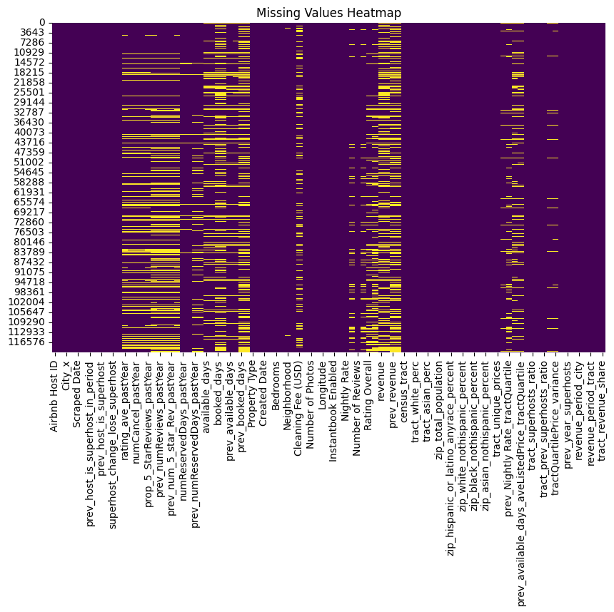
Data Preprocessing – Missing Values

Slide 25
Data Preprocessing – Missing Values

Slide 26
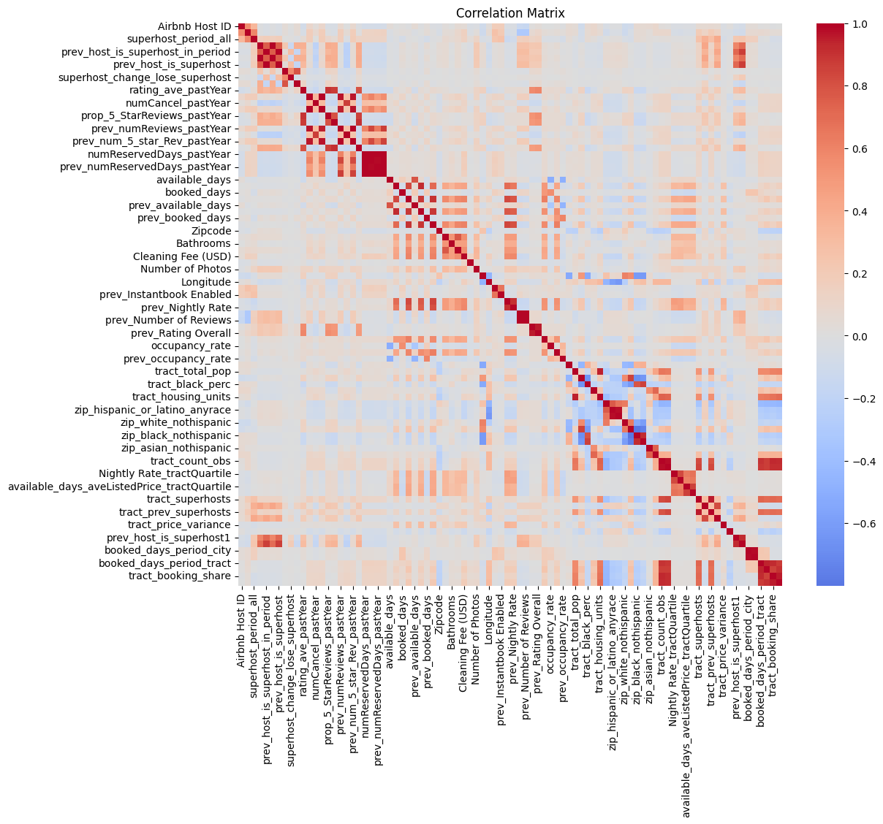
Data Preprocessing – Correlation

Slide 27
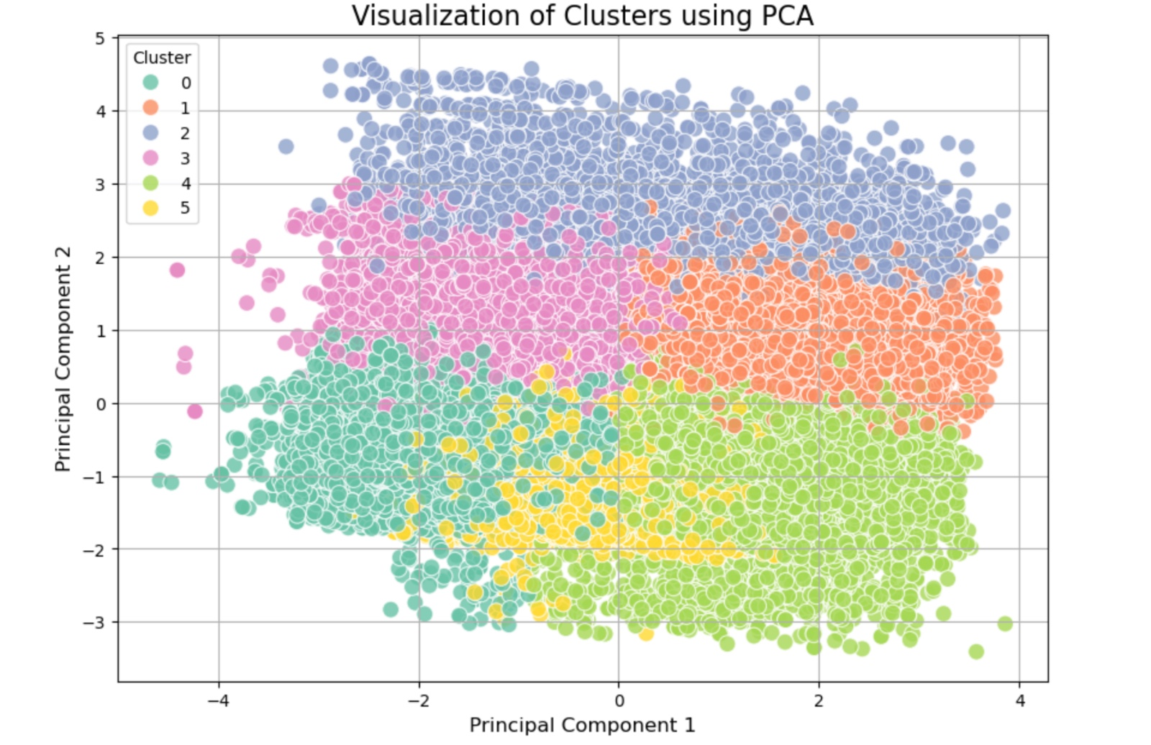
Clustering Results

Slide 28
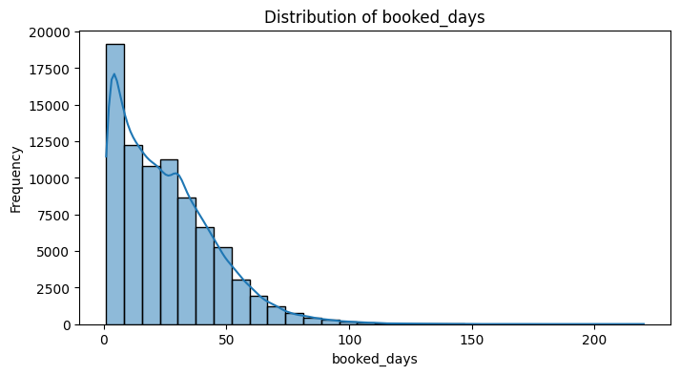
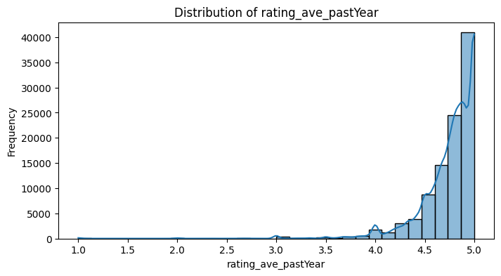
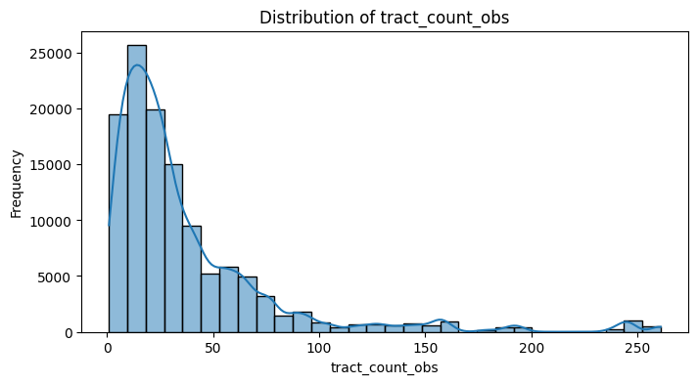
Data Preprocessing – Skewness

Slide 29
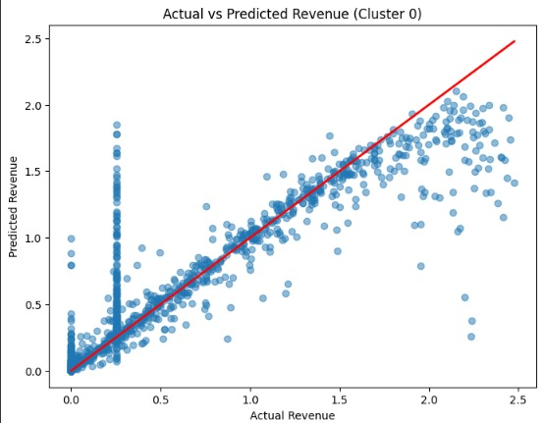
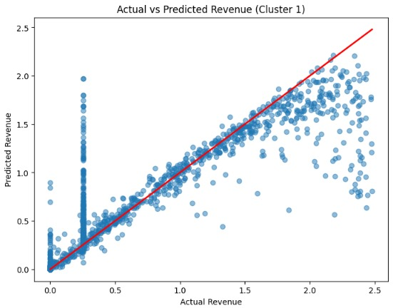
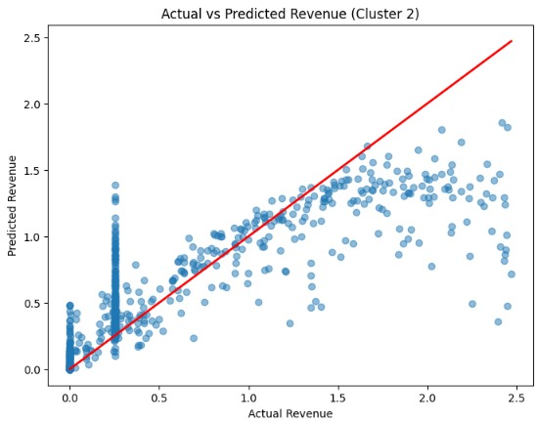
Revenue Prediction Model Results – Clusters 1 - 3

Slide 30
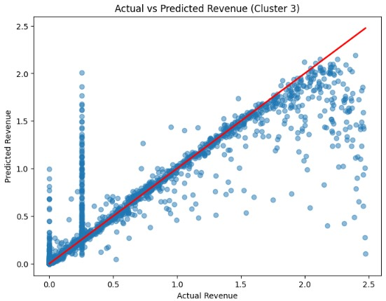
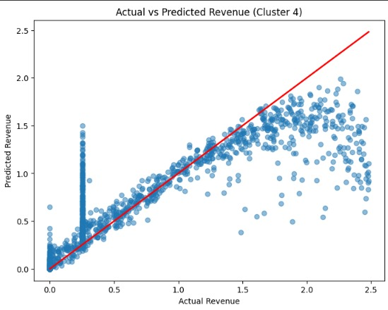
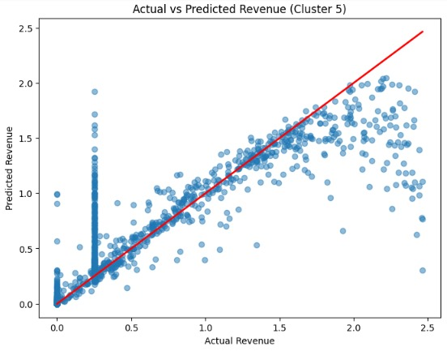
Revenue Prediction Model Results – Clusters 4 - 6

Slide 31
References
Clustering Techniques:
Jain, A. K. (2010). Data clustering: 50 years beyond K-means. Pattern Recognition Letters, 31(8), 651-666. Explores the foundational concepts of K-means clustering, its limitations, and extensions.
PCA and Dimensionality Reduction:
Jolliffe, I. T. (2002). Principal Component Analysis (2nd ed.). Springer. Covers the theoretical and practical aspects of PCA for reducing dimensionality and interpreting data.
Data Preprocessing and Feature Scaling:
Han, J., Pei, J., & Kamber, M. (2011). Data Mining: Concepts and Techniques (3rd ed.). Elsevier. Includes best practices for data cleaning, scaling, and feature engineering.
Power Transformations:
Box, G. E. P., & Cox, D. R. (1964). An Analysis of Transformations. Journal of the Royal Statistical Society: Series B, 26(2), 211-252. Discusses methods like the Yeo-Johnson transformation for stabilizing variance and normalizing data distributions.
Machine Learning with Python:
Géron, A. (2019). Hands-On Machine Learning with Scikit-Learn, Keras, and TensorFlow (2nd ed.). O'Reilly Media. A practical guide to implementing machine learning techniques, including clustering, preprocessing, and regression.
Evaluation of Clustering Results:
Rousseeuw, P. J. (1987). Silhouettes: A graphical aid to the interpretation and validation of cluster analysis. Journal of Computational and Applied Mathematics, 20, 53-65. Provides methods to evaluate clustering performance and interpret results.
Superhost Prediction (Airbnb Context):
Zervas, G., Proserpio, D., & Byers, J. W. (2017). The Rise of the Sharing Economy: Estimating the Impact of Airbnb on the Hotel Industry. Journal of Marketing Research, 54(5), 687–705. Contextual insights into Airbnb metrics and their impact on host and property success.
Data Aggregation Techniques:
Wickham, H., & Grolemund, G. (2016). R for Data Science: Import, Tidy, Transform, Visualize, and Model Data. O'Reilly Media. While focused on R, this book provides principles of data aggregation and grouping, which are transferable to Python.
Airbnb Official Website: https://www.airbnb.com Insights into Airbnb’s Superhost criteria and general operational metrics.

